Slide 1
Social Media 101
Seminole County Public Schools

Slide 2
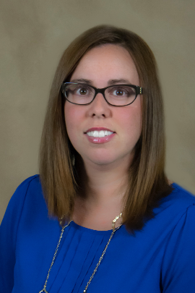
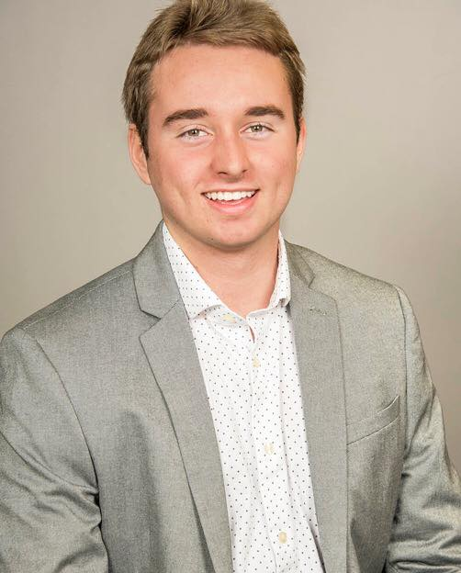
Who are we?
Cristina Lehman
Marketing/Communication Specialist
Office of Communications
Holton Mills
RSVP of SCPS
Community Involvement

Slide 3
Objectives
How it works?
Why participate in social media?
What to post?
How to interact with social media?

Slide 4
How it works?
Setting up a district/school-based Facebook and/or Twitter Page
Must have district approval for school-based social media pages
Never use your personal page!
Facebook –
You can have a “Person” account and a “Page” account on Facebook. You need a “Person” account to set up a “Page” account.
Set up a “fake” person account.
Then set up a pages account for your school/program.
Make sure not to post from the “fake” person account.
Suggestion – do not upload any pictures, even a profile picture, to the fake account. It makes it easier to know what account you are posting from.
Twitter –
Create a Twitter account.

Slide 5
Examples
“Fake” person account
The “Page” connected to the fake account
The “Page” account

Slide 6
Why participate in Social Media?
Research shows that 83% of people 30-49 that go online have a Facebook page!
Promotion! Promotion! Promotion!
Promote what is currently happening with your programs/schools.
Promote new programs to recruit new opportunities.
When you have business partners, this is a great tool to promote their assistance.
Make sure you are tagging the business in your posts.
Helps build excitement for your programs and events.
Helps potential parents learn more about a school they are interested in.
Helps get information out much quicker.

Slide 7
Examples
Build excitement
Get the word out
Promoting events

Slide 8
What to Post?
Allowing “backstage access” to an event that would not normally be open to the public.
Highlighting the work being done at the schools
With students, programs, PTA events, volunteers, etc.
Promoting new programs and important upcoming events
Showcasing partnerships
Show appreciation for others by highlighting them on social media
Social media works best as a team activity!
Ask for team members to send you pictures and post it on your pages.
Take “active” pictures
Pictures need to be interesting, compelling and dynamic.
Hashtags
Proper use and how to search them

Slide 9
Twitter Examples
Promoting new programs
“Backstage pass” and “cross promotion”
Showcasing partnerships

Slide 10
Facebook Examples
Highlight work done at schools
Showcasing partnerships
Promoting important upcoming events

Slide 11
Hashtag Examples
Don’t – be inconsistent. Also, a hashtag does not tag someone.
Do – market a specific hashtag at an event to retweet pictures and have more interaction with followers.

Slide 12
How to interact with social media?
Why like/share/retweet posts?
Cross promote
Facebook dropdown element – Can be tricky!
Providing Customer Service
Scheduling posts
Advantages
TweetDeck for scheduling Twitter posts
Ask follower for assistance promoting your page
Consistency is KEY!
If you are not consistently posting, then you shouldn’t have a page.

Slide 13
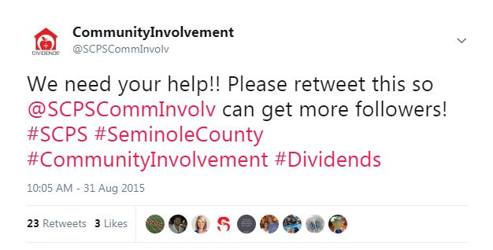
Examples
Ask for help promoting your new page
Make sure when you want to Like or Comment on a Facebook post, you use the dropdown and choose the correct page.

Slide 14
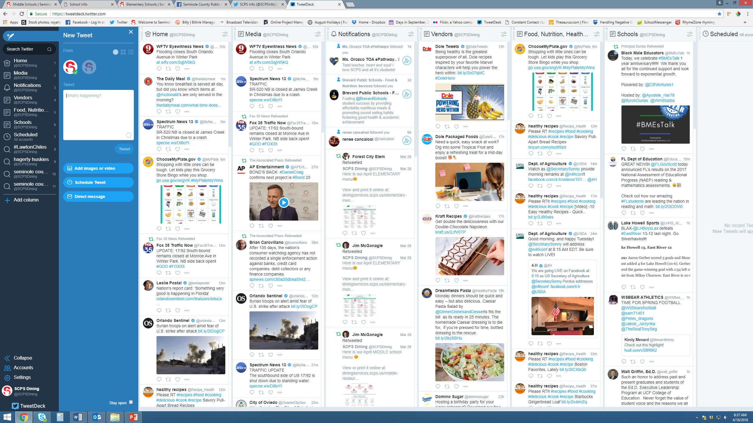
Examples - TweetDeck

Slide 15
Thank you!
Any Questions?

